Slide 1
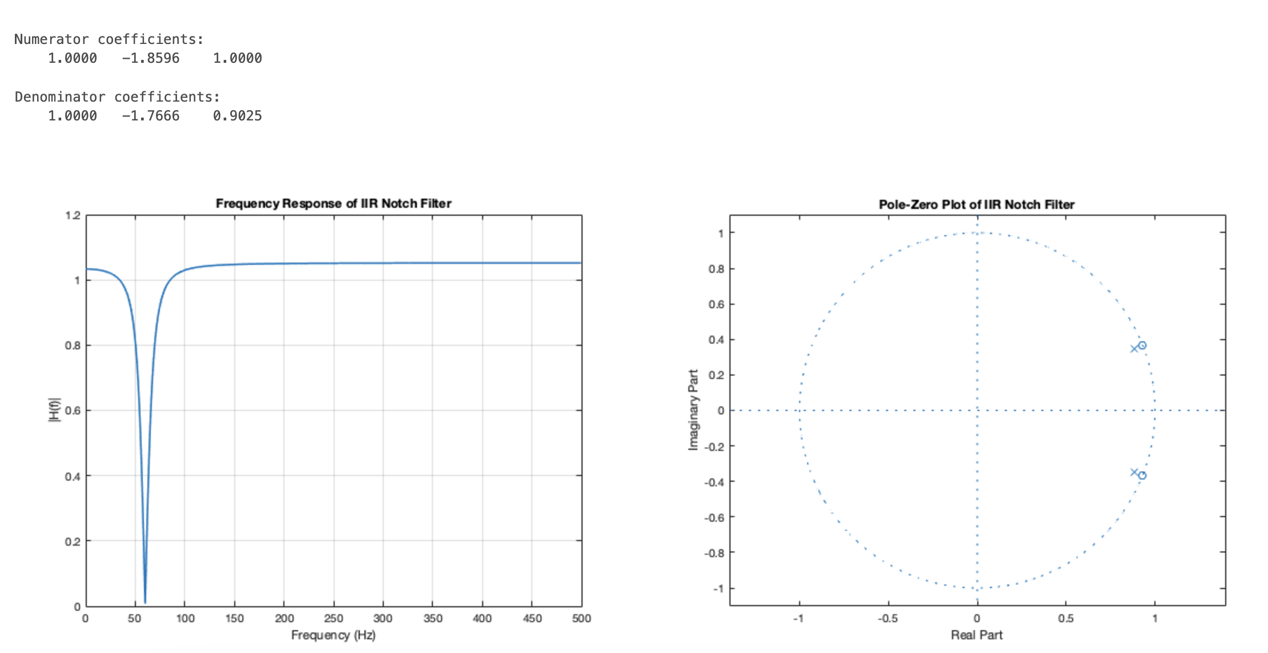
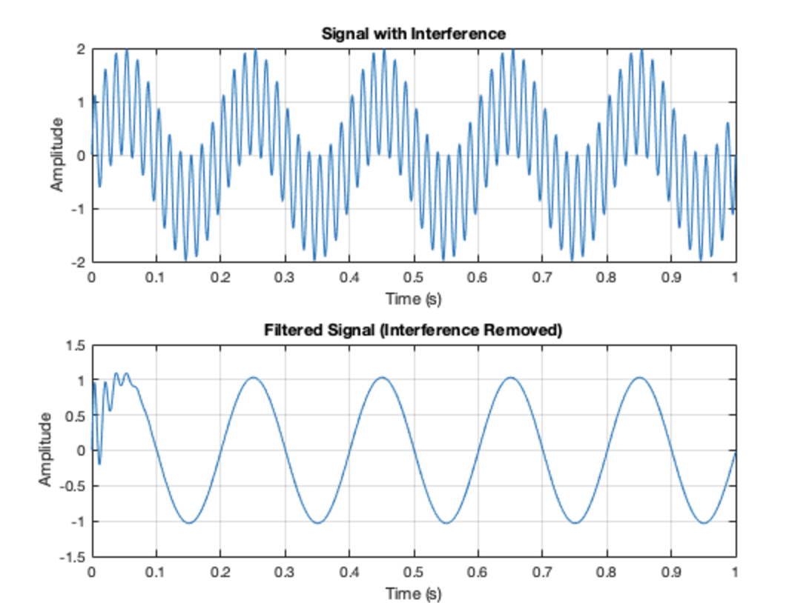
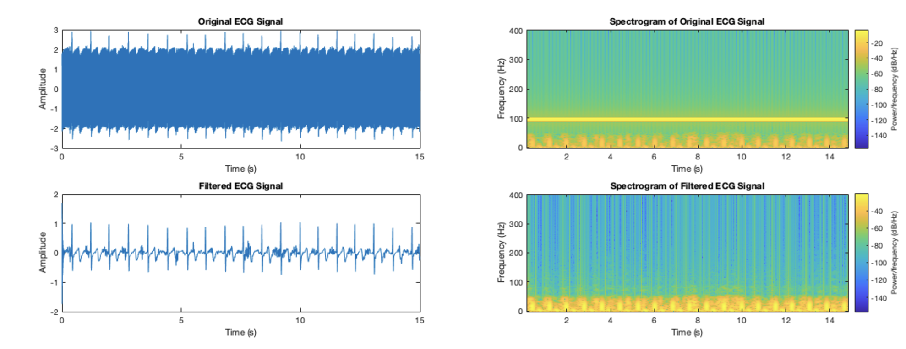
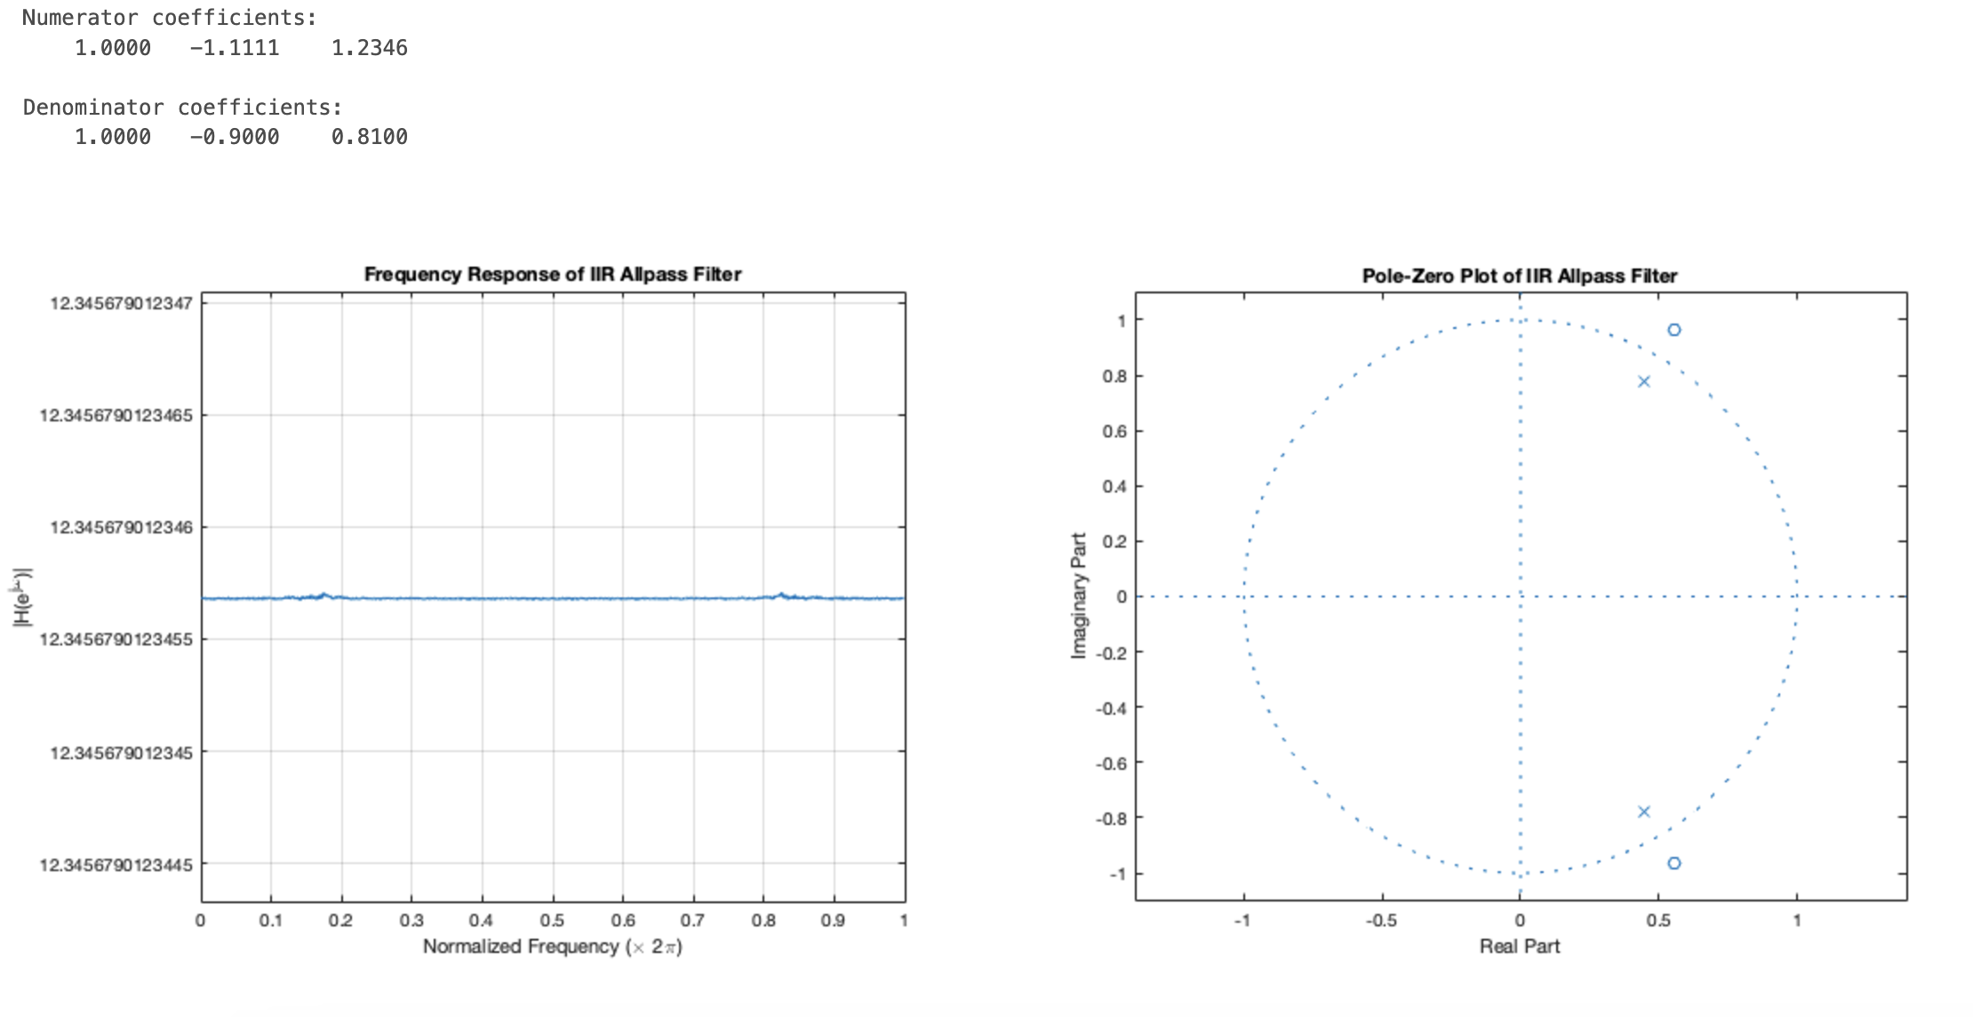
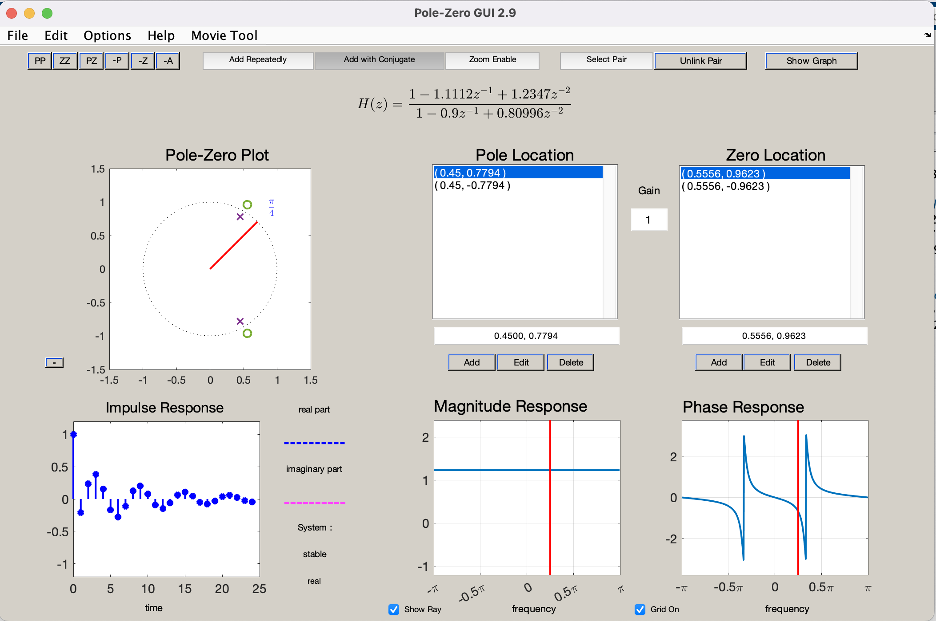
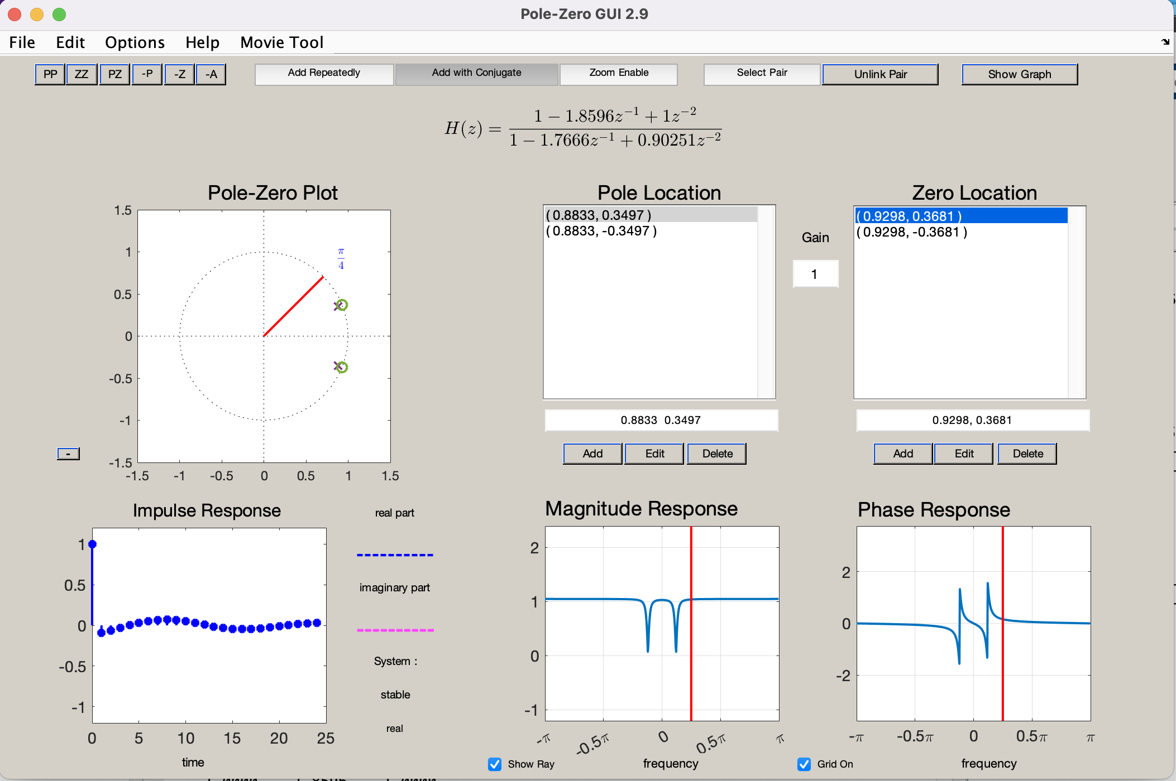
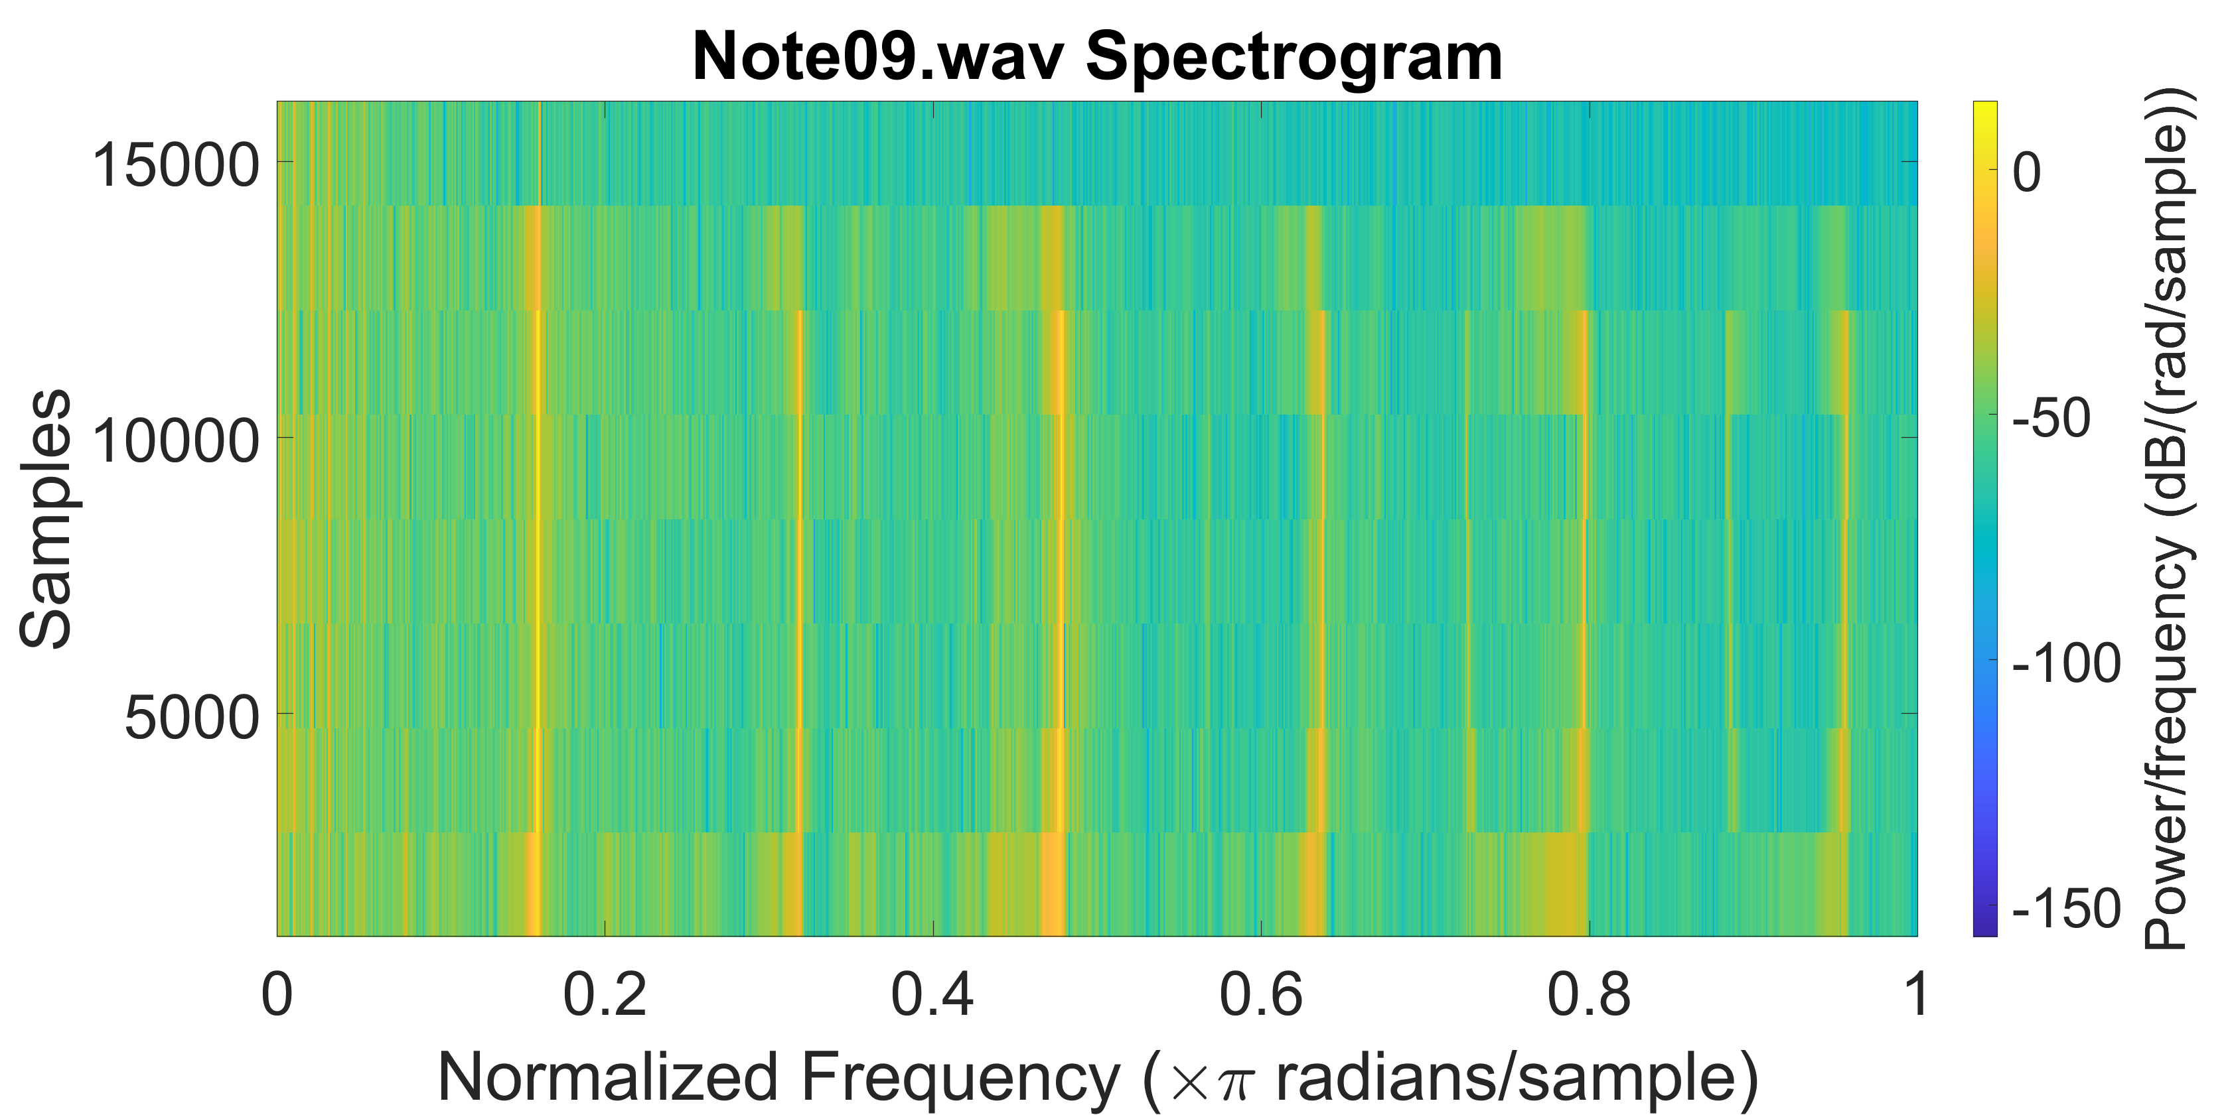
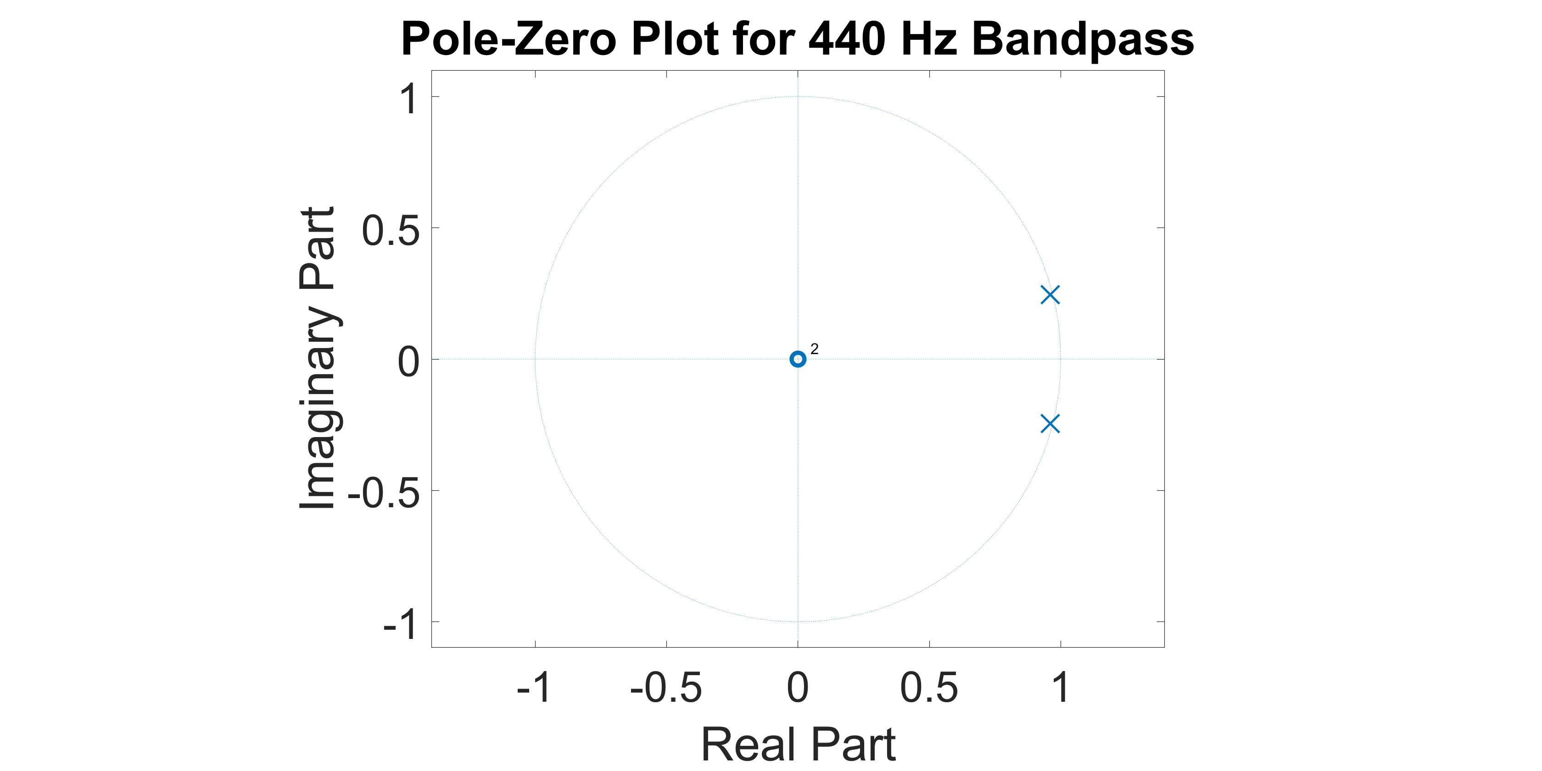
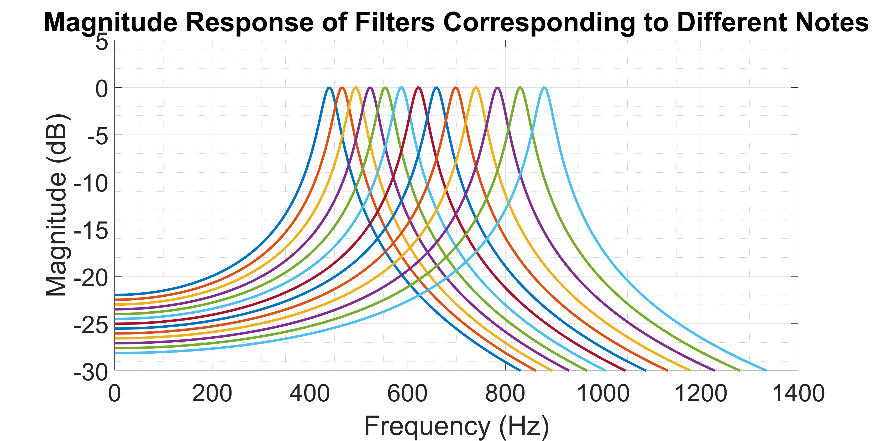

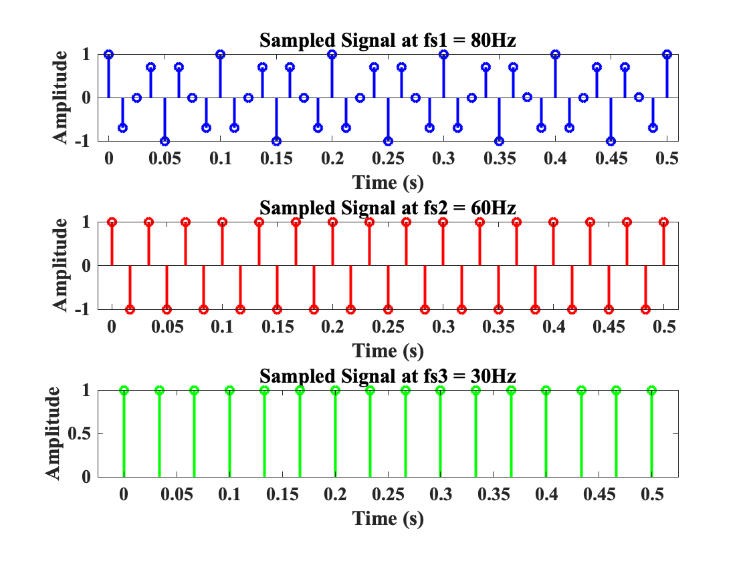
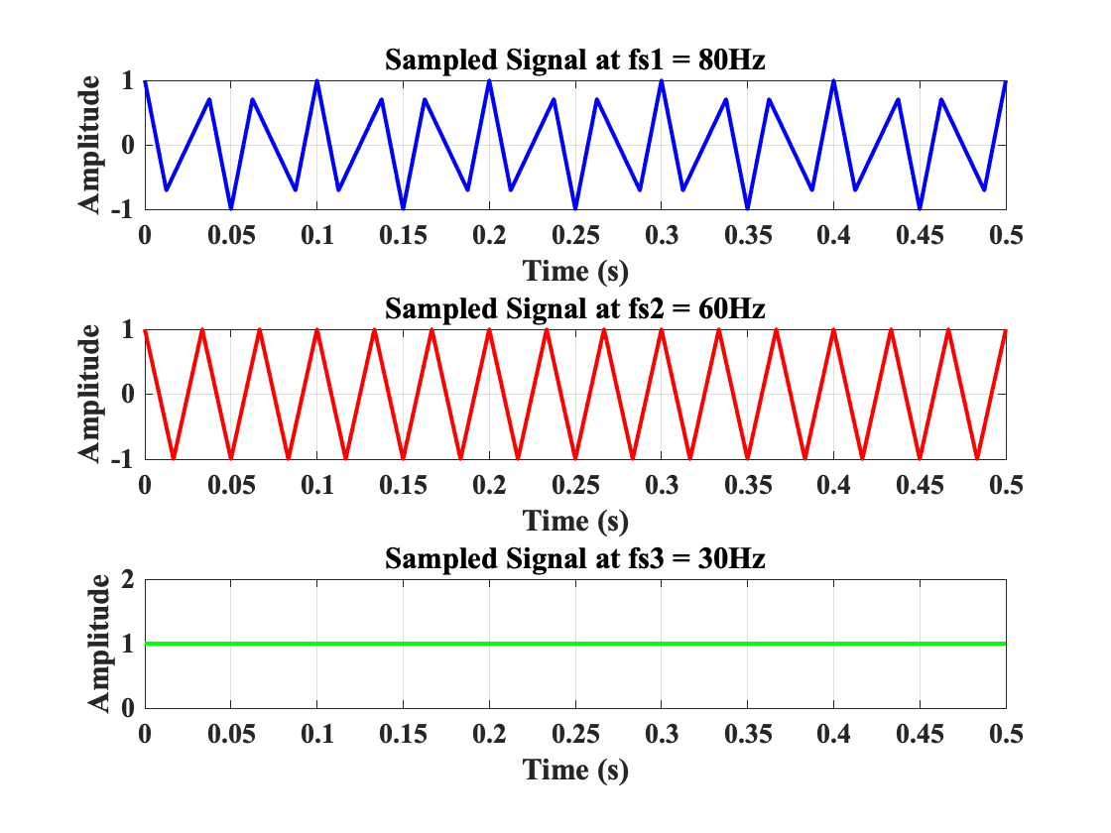
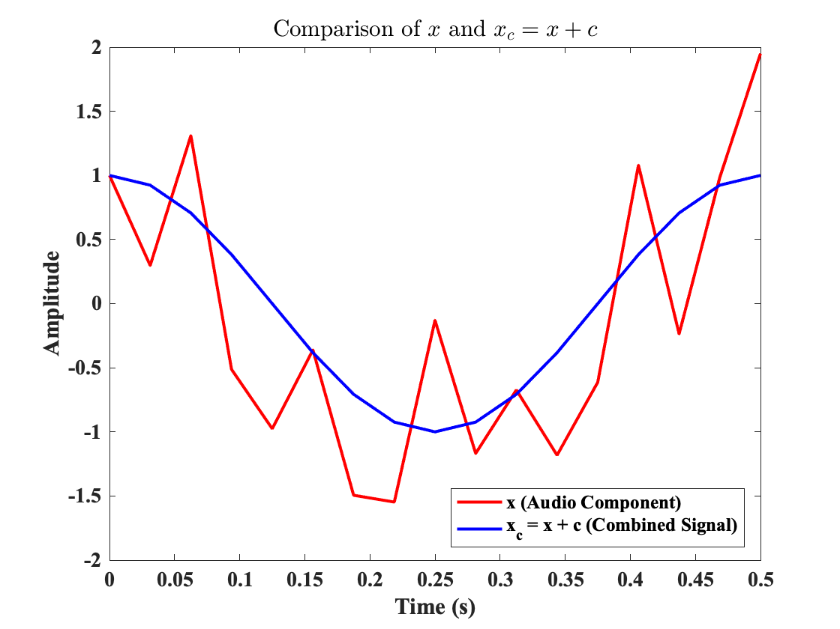
Project 11: IIR Filters
Rhett Redd, Mitch Bateman, Rigo Carreto, Todd Nielsen
Introduction
IIR Allpass Filter
An Allpass filter’s magnitude response is flat, meaning all frequencies are passed equally.
IIR Notch Filter
To design a filter that removes specific interference frequencies, such as 60 Hz noise in ECG signals.
Sinusoidal Interference
To apply the notch filter to a noisy ECG signal and evaluate its effectiveness
Conclusion
Infinite Impulse Response (IIR) filters are essential tools in signal processing, valued for their efficiency and ability to model systems with feedback. Unlike Finite Impulse Response (FIR) filters, IIR filters produce an impulse response that theoretically extends infinitely due to their recursive structure.
This study explores the fundamental principles of IIR filters, focusing on their design and behavior. Practical applications include note detection, song recognition, and ECG signal filtering, which demonstrate the versatility of IIR filters in real-world scenarios.
This project demonstrates the principles of digital signal processing through three distinct applications. First, we explored the design and implementation of filters—including notch, FIR, and bandpass filters—using tools like MATLAB and the PeZ GUI. By manipulating poles and zeros, we achieved desired signal characteristics, with a key application being the use of a notch filter to remove interference from an ECG signal while preserving its original integrity. This highlights the importance of filter design in medical signal processing for tasks such as noise suppression and signal enhancement.
Second, a note detection algorithm was developed using bandpass filters, demonstrating its ability to identify frequencies within audio signals. This application showcases the potential of signal processing in real-world scenarios, particularly in music analysis and audio technology.
Lastly, a song recognition system was implemented by analyzing a .wav file in MATLAB. The audio was segmented into smaller parts, allowing for the detection of individual notes or silence. The identified notes were synthesized into a new .wav file, illustrating the creative applications of digital signal processing in music synthesis and reconstruction.
These projects underscore the versatility and real-world relevance of digital signal processing across fields such as healthcare and audio engineering.
IIR Filter Fundamentals
Note Detection
Use angular frequency of possible notes to define poles. Make sure poles are inside the circle to avoid instability.
Create filters centered at different frequencies/notes.
Data from each file gets filtered by each filter and the power is checked for each one. The highest power output is selected as the frequency.
Poles and Zeros
- Poles: Values of z that make the denominator of H(z) zero. These control stability and create peaks in the frequency response.
- Zeros: Values of z that make the numerator of H(z) zero. These determine frequencies that are attenuated (nulls).
Stability Criterion
- An IIR filter is stable if all poles lie within the unit circle in the z-plane.
Common Types of IIR Filters
- Low-Pass Filters: Pass low frequencies and attenuate high frequencies.
Example: Removing high-frequency noise in audio signals.
- High-Pass Filters: Pass high frequencies and attenuate low frequencies.
Example: Enhancing high-pitched sounds in speech processing.
- Band-Pass Filters: Pass frequencies within a specific range and attenuate those outside.
Example: Isolating frequencies in communication systems.
- Band-Stop (Notch) Filters: Attenuate frequencies within a specific range and pass those outside.
Example: Eliminating 50/60 Hz powerline interference in ECG signals.
Frequency Content of File
Results:
Note02.wav: 440 Hz
Note03.wav: 494 Hz
Note04.wav: 554 Hz
Note05.wav: 587 Hz
Note06.wav: 659 Hz
Note07.wav: 740 Hz
Note08.wav: 831 Hz
Note09.wav: 880 Hz
Mini Project 6
In this project, I successfully developed a MATLAB function to analyze a .wav file containing a simple song and identify the notes being played. I began by reading the audio file into a large vector and dividing it into smaller segments of equal duration using MATLAB's reshape command. Each segment was processed using a custom noteDetect function, which identified the loudest note or determined silence based on a predefined threshold. The output was a sequence of detected notes for each segment, which I refined to display only the played notes in a more compact format.
Contributions
Mitch Bateman – Introduction
Rigo Carreto – ECG Signal Filtering
Rhett Redd – Note Detection
Todd Nielsen – Song Detection
Additionally, I linked the results to a previous lab by resynthesizing the detected notes at double the tempo, generating a new .wav file as the output.
Original Audio
Note Detected
Double Tempo

